Slide 1
Interactive Visual
Data Analysis
01 - Introduction

Slide 2
Objectives
What is interactive visual data analysis: Learn basic intuition behind analyzing data via interactive visualization
What is interactive visual data analysis good for: Understand the benefits of combining visual, interactive and computational data analysis methods
How does interactive visual data analysis look concretely: Learn first examples of interactive visual data analysis solutions

Slide 3
Overview
What is interactive visual data analysis
Five Ws (what, why, who, where, when)
Introductory examples
  Simple graph visualization
  Enhancing the data analysis with dynamic filtering and multiple views
  Considering advanced techniques

Slide 4
Why interactive visual data analysis?
Huge amounts of data collected and generated
Challenge of the information age:
“How to gain insight into large heterogeneous data?”

Slide 5
Why interactive visual data analysis?
Support humans in understanding complex phenomena
This usually involves gaining insight into large data
Is it enough to?
  Only let machines analyze data computationally
  Only let humans strive for insight manually
No, instead!
  Combine forces: Take advantage of humans and machines!

Slide 6
What is interactive visual data analysis?
Interactive visual data analysis is centered around
the idea of combining
  Visualization
  Interaction
  Computation
to facilitate analysis and understanding of large and complex data.
“
Visual analytics is the science of analytical reasoning facilitated by interactive visual interfaces.
— Thomas & Cook, 2005

Slide 7
What is interactive visual data analysis?
“
Computation
Data queries
Data abstraction
  Sampling
  Filtering
  Clustering
  Dimensionality reduction
  Classification
  Prediction
  Think about: What else can sensibly be computed?
The purpose of computing is insight, not numbers.
— Richard Hamming, 1962
Notes:
Other computations
Statistics (average, min, max)
Outlier detection
Simulations (climate models, finite element method)

Slide 8
What is interactive visual data analysis?
Computation
Advantages
  Generate exact and reproducible results
  Operate on huge amounts of data
Disadvantages
  Requires well-defined formal description of problem → cannot operate on ill-defined open-ended problems
  Follows strictly the programmed path, cannot react to exceptional unforeseen circumstances
Notes:
Advantages:
- Computer

Slide 9
What is interactive visual data analysis?
Visualization
“
Visualization is a method of computing. It transforms the symbolic into the geometric, enabling researchers to observe their simulations and computations. Visualization offers a method for seeing the unseen. It enriches the process of scientific discovery and fosters profound and unexpected insights.
— McCormick et al., 1989

Slide 10
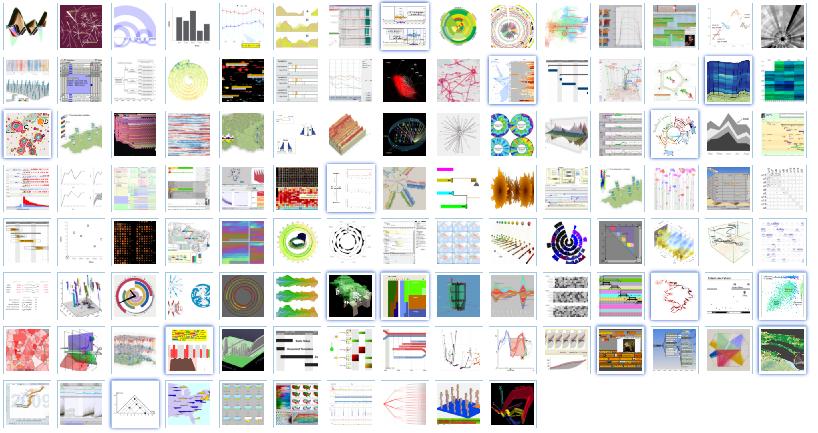
What is interactive visual data analysis?
Visualization
Map data to visual representations
Example:
Visualization of temporal data
Many more techniques for all kinds of data
https://browser.timeviz.net

Slide 11
What is interactive visual data analysis?
Visualization
Advantages
  Can make characteristics of data understandable
  Utilizes human interpretation and reasoning capabilities
Disadvantages
  Insight might not be crisp and clear: Is a perceived pattern indeed a pattern in the data or just an artifact of the visual encoding?
  Requires normal vision: What about people with visual impairments?
  May be misleading (if not designed appropriately, deliberately or accidentally)
Notes:
Other disadvantages:

Slide 12
What is interactive visual data analysis?
“
A graphic is not ‘drawn’ once and for all; it is ‘constructed’ and reconstructed until it reveals all the relationships constituted by the interplay of the data. The best graphic operations are those carried out by the decision-maker himself.
— Bertin, 1981
Interaction
“
Are we analyzing data? Then we should be manipulating the data themselves;
or if we are designing an analysis of data, we should be manipulating the analytic structures themselves.
— Hutchins et al., 1985
“
Interaction is the fuel for analytic discourse.
— Thomas & Cook, 2005
“
While visual representations may provoke curiosity,
interaction provides the means to satisfy it.
— Tominski & Schumann, 2020

Slide 13
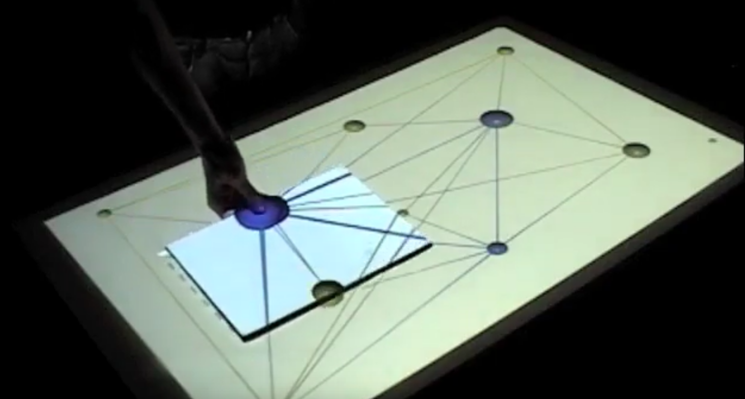
What is interactive visual data analysis?
Interaction
Interactively explore the data
Example:
Tangible views
Many more techniques for all kinds of tasks
https://www.youtube.com/watch?v=Pw-rlNj2IAY

Slide 14
What is interactive visual data analysis?
Interaction
Advantages
  Brings flexibility to data analysis
  Support human creative problem solving
Disadvantages
  May be difficult to discover
  Can be tiresome and costly
  Requires additional effort to ensure reproducibility

Slide 15
What is interactive visual data analysis?
When to apply interactive visual data analysis?
Clear problem, answer can be computed, do:
Computation
Ill-defined problem, answer can hardly be computed, add:
Visualization
If single computation and visual representation do not suffice, add:
Interaction
Many real-world problems are here!

Slide 16
What is interactive visual data analysis?
In a nutshell
Leverage the capabilities of humans and computers by combining computational, visual, and interactive methods to enable and support the analysis and understanding of large and complex data.
Computation
Data bases, data mining, statistics, machine learning, modeling and simulation, graph mining ...
Visualization
Computer graphics, display devices, visual representations, perception, cognition, ...
Interaction
Human-computer interaction, interaction design, interaction devices, usability, ...

Slide 17
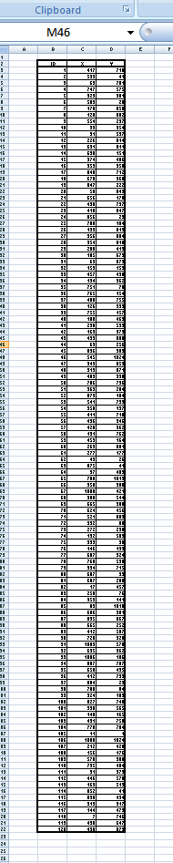
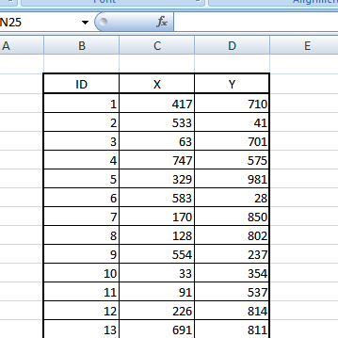
From data to insight
Example data

Slide 18
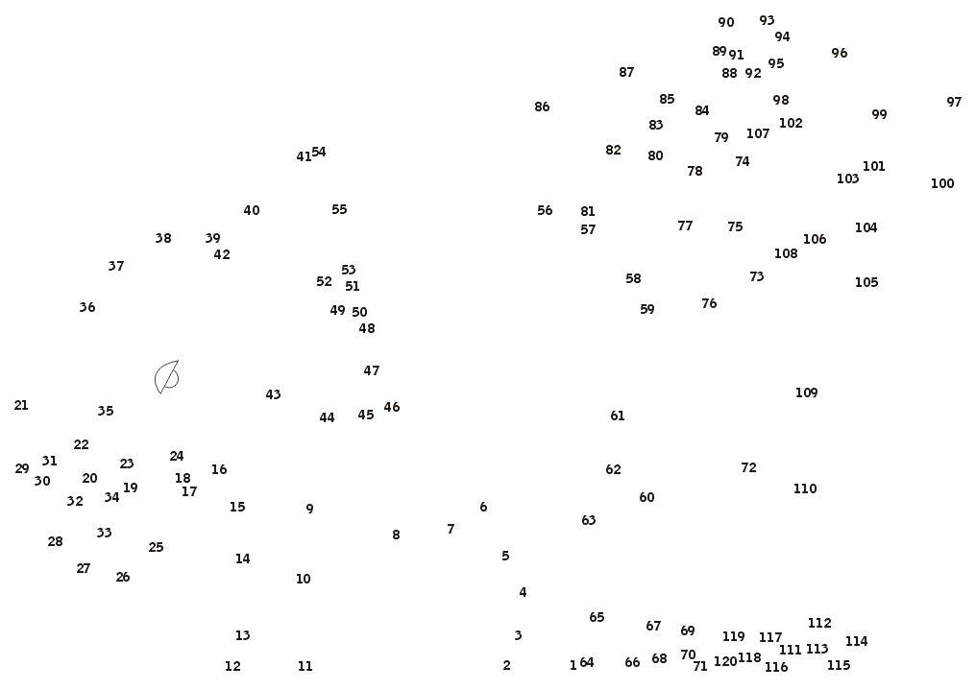
From data to insight
Visualization

Slide 19
From Data to Insight
Clustering

Slide 20
From data to insight
Alternative
encoding

Slide 21
From data to insight
Insight derived

Slide 22
Why human judgement matters
Descriptive statistics
Anscombe’s quartet
Same results, but different data!
I
x | y
10.0 | 8.04
8.0 | 6.95
13.0 | 7.58
9.0 | 8.81
11.0 | 8.33
14.0 | 9.96
6.0 | 7.24
4.0 | 4.26
12.0 | 10.84
7.0 | 4.82
5.0 | 5.68
II
x | y
10.0 | 9.14
8.0 | 8.14
13.0 | 8.74
9.0 | 8.77
11.0 | 9.26
14.0 | 8.10
6.0 | 6.13
4.0 | 3.10
12.0 | 9.13
7.0 | 7.26
5.0 | 4.74
III
x | y
10.0 | 7.46
8.0 | 6.77
13.0 | 12.74
9.0 | 7.11
11.0 | 7.81
14.0 | 8.84
6.0 | 6.08
4.0 | 5.39
12.0 | 8.15
7.0 | 6.42
5.0 | 5.73
IV
x | y
8.0 | 6.58
8.0 | 5.76
8.0 | 7.71
8.0 | 8.84
8.0 | 8.47
8.0 | 7.04
8.0 | 5.25
19.0 | 12.50
8.0 | 5.56
8.0 | 7.91
8.0 | 6.89
Property | Value
Mean of x | 9
Variance of x | 11
Mean of y | 7.50
Variance of y | 4.125
Correlation between x and y | 0.816
Linear regression | y = 3.00 + 0.500x
Anscombe‘s quartet

Slide 23
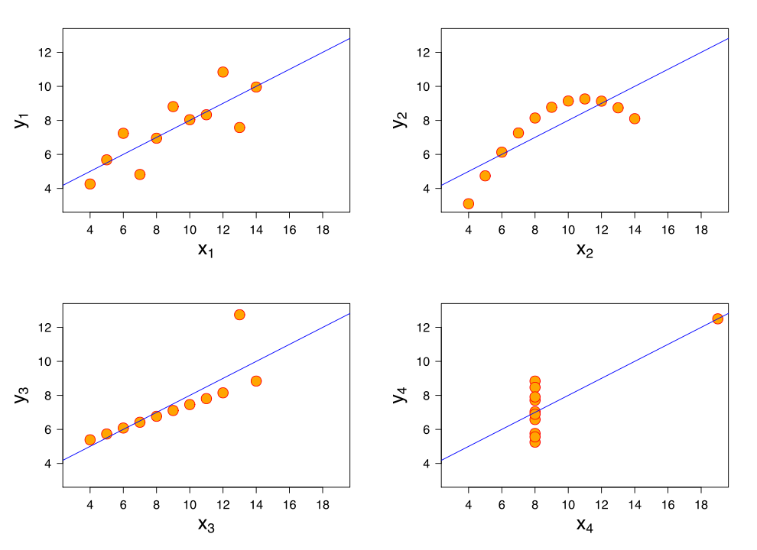
Why human judgement matters
Visualization
Anscombe’s quartet
Visualizations show different data!
I
x | y
10.0 | 8.04
8.0 | 6.95
13.0 | 7.58
9.0 | 8.81
11.0 | 8.33
14.0 | 9.96
6.0 | 7.24
4.0 | 4.26
12.0 | 10.84
7.0 | 4.82
5.0 | 5.68
II
x | y
10.0 | 9.14
8.0 | 8.14
13.0 | 8.74
9.0 | 8.77
11.0 | 9.26
14.0 | 8.10
6.0 | 6.13
4.0 | 3.10
12.0 | 9.13
7.0 | 7.26
5.0 | 4.74
III
x | y
10.0 | 7.46
8.0 | 6.77
13.0 | 12.74
9.0 | 7.11
11.0 | 7.81
14.0 | 8.84
6.0 | 6.08
4.0 | 5.39
12.0 | 8.15
7.0 | 6.42
5.0 | 5.73
IV
x | y
8.0 | 6.58
8.0 | 5.76
8.0 | 7.71
8.0 | 8.84
8.0 | 8.47
8.0 | 7.04
8.0 | 5.25
19.0 | 12.50
8.0 | 5.56
8.0 | 7.91
8.0 | 6.89
Anscombe‘s quartet

Slide 24
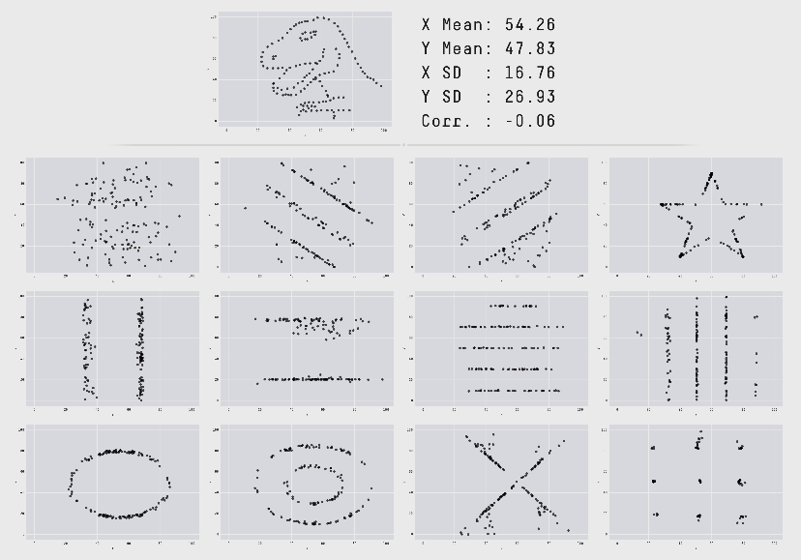
Why human judgement matters
Anscombe’s quartet
“
...make both calculations and graphs. Both sorts of output should be studied; each will contribute to understanding.
— Anscombe, 1973
More examples: https://www.autodesk.com/research/publications/same-stats-different-graphs

Slide 25
What is interactive visual data analysis?
Human in the Loop
Problems with classic analysis methods (usually black-box)
  Transparency: Can we understand how results are derived?
  Interpretation: Can we interpret the results?
  Trust: Can we trust the results?
Interactive visual methods aim to enhance the analysis to make it
  Transparent: Make observable what is going on.
  Interpretable: Map to easy-to-interpret visual representations.
  Trust: Through understanding make results trustable.

Slide 26
What is interactive visual data analysis?
Human in the Loop
Visual Interface
Human
Computer

Slide 27
Five Ws of interactive visual data analysis
Five Ws
  What
  Why
  Who
  Where
  When
Knowledge of these Ws is critical to be able to select, apply, or develop appropriate solutions
Notes:
Other types of data
Weather data
Health data
Election data
Other data characteristics
Data size
Data structure
Abstract vs. spatial vs. temporal data

Slide 28
Five Ws of interactive visual data analysis
What data are to be analyzed?
Many different types of data
  Measure or observed: Census data, movement data, …
  Conceptualized or simulated: Biological networks, disease spread, …
  Meta-data: Parameters, internal intermediate results (e.g., of AI methods)
  Think about: What types of data have you been in contact with?
Each data type has its own individual characteristics
  Scale
  Dimensionality
  Think about: What other characteristics might be relevant?
Notes:
Other types of data
Weather data
Health data
Election data
Other data characteristics
Data size
Data structure
Abstract vs. spatial vs. temporal data

Slide 29
Five Ws of interactive visual data analysis
Why are the data analyzed?
Objective is to help people accomplish their goals in various domains
  Understand people’s voting behavior
  Determine governing factors in biological systems
  Optimize AI method results
  Think about: What goals might exist in other application domains?
Goals involve several analytic tasks
  Identify data values
  Detect trends
  Think about: What other tasks could be supported?
Notes:
Other application goals:
Development of effective drugs
Prevent or counteract network security breaches
Investigate fraudulent financial transaction behavior
Other tasks:
Locate data values
Detect communalities and differences
Correct or edit data values

Slide 30
Five Ws of interactive visual data analysis
Who will analyze the data?
Different groups of users need different analysis tools
  Casual people exploring their own data
  Experts developing new scientific methods and tools
  Investors exploring data in search for market opportunities
Take into account
  Human factors (perception and cognition)
  Individual abilities
  User preferences

Slide 31
Five Ws of interactive visual data analysis
Where will the data be analyzed?
Computer technology offers broad spectrum of devices
  Regular desktop computer
  Interactive surfaces
  Large high-resolution display walls
  Think about: Where else might interactive visual data analysis be conducted?
Device characteristics
  Display properties
  Interaction modalities
  Computational power
Notes:
Where else
Smartphones and smartwatches
Multi-display environments
Virtual and augmented reality (VR and AR) aka. Immersive Analytics

Slide 32
Five Ws of interactive visual data analysis
When will the data be analyzed?
The right tool (visualization, interaction, and computation) must be at hand at the right time
Data analysis may
  Allow free operation and combination of tools
  Follow domain-specific workflows

Slide 33
Five Ws of interactive visual data analysis
Five Ws summary
Many influencing factors (e.g., data types, analytic tasks, user groups, analysis environments, domain conventions)
Interactive visual data analysis solutions must be tailored for specific purpose and setting
Wealth of analytic questions → Need a large variety of concepts and techniques

Slide 34
Introductory examples
Simple graph visualization
What: Characters appearing in Victor Hugo’s novel Les Miserables
Why: Understand connections between characters
  Who is connected to whom?
  Who takes a central role?
  Which persons built communities?
Who: Regular people interested in the novel
Where: Standard computer displays
When: Casual occasional use

Slide 35
Introductory examples
Simple graph visualization
Data: Graph G = (V, E, w)
  V
    Set of vertices (or nodes)
    Characters appearing in the novel
  E
    Set of links (or edges)
    A link exists when two characters co-occur in a chapter
  w : E → N
    Weight function assigns each edge a weight
    Number of chapters in which the same two characters co-occur

Slide 36
Introductory examples
Simple graph visualization
Given: Graph data
  77 nodes and 254 edges
  JSON format
Find: Visual representation
that answers our analytic questions
  How does the graph structure look like?
  Who is central in the graph?
  Who co-occurs frequently?

Slide 37
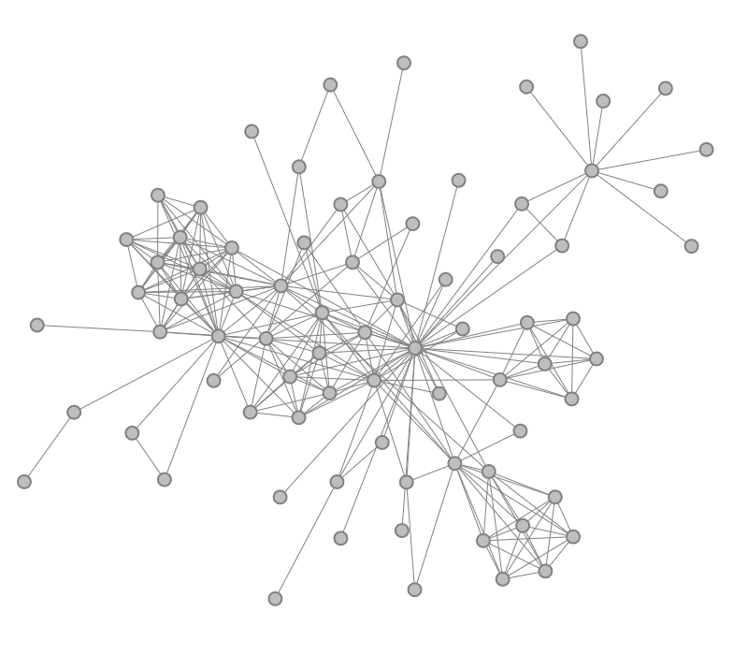
Introductory examples
Simple graph visualization
How does the graph structure look like?
  How to represent and layout nodes?
    Dots laid out with force-directed algorithm
    Think about: Alternative node representations?
  How to represent and route edges?
    Edges shown as straight lines between nodes
    Think about: Alternative edge representations?
This type of visual representation is called a node-link diagram.
Notes:
Alternatives for nodes:
Icons with character faces
Nodes placed according to time of occurrence in the novel
Alternatives for edges:
Curved links
Orthogonal links

Slide 38
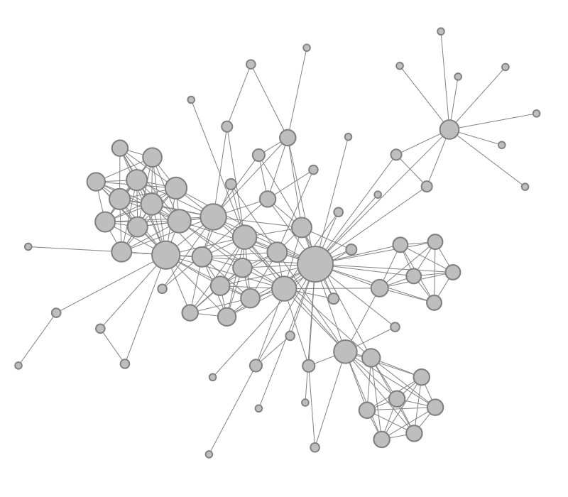
Introductory examples
Simple graph visualization
Who is central in the graph?
  Visually encode node degree
    Vary size of nodes
    Make high-degree nodes bigger
    Make low-degree nodes smaller
The process of encoding a data attribute graphically is called visual mapping.

Slide 39
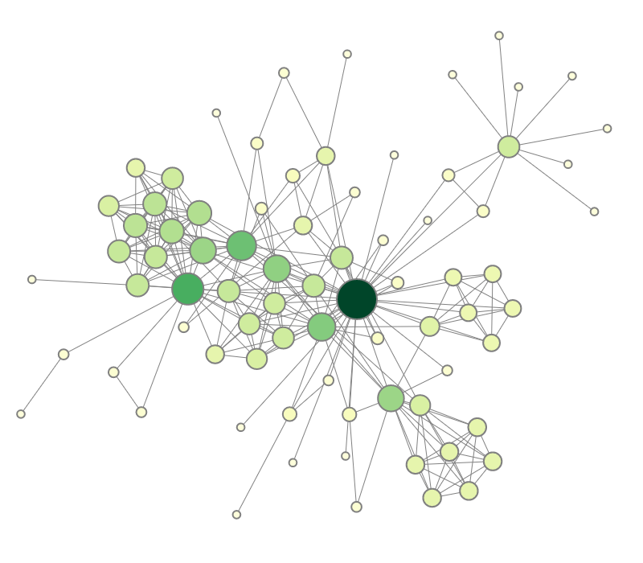
Introductory examples
Simple graph visualization
Who is central in the graph?
  Emphasize central nodes via color
    Color dots based on node degree
    Make high-degree nodes darker
    Make low-degree nodes lighter
Encoding the same data (node degree) in different ways (size and color) is called redundant mapping.

Slide 40
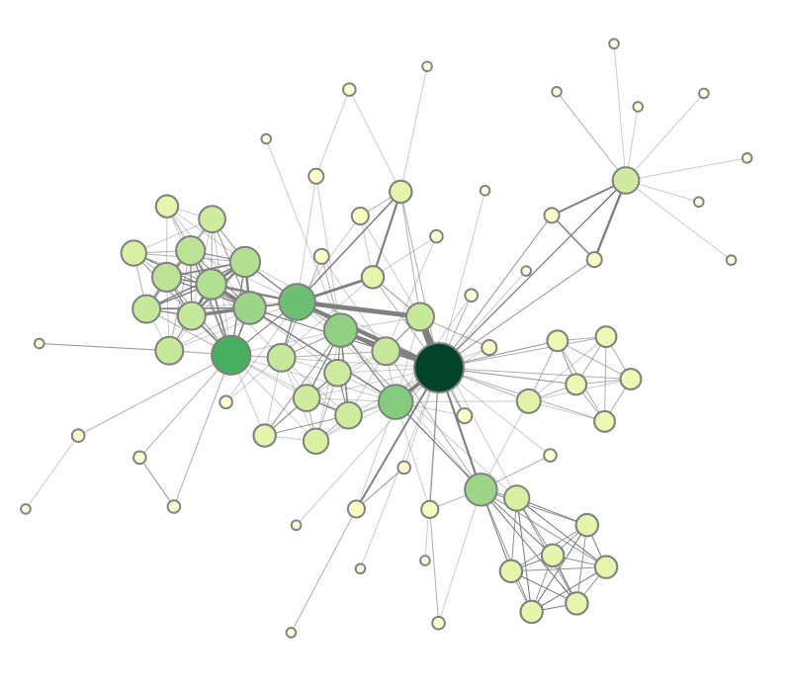
Introductory examples
Simple graph visualization
Who co-occurs most frequently?
  Visually encode edge weight
    Vary line width of links
    Thicker links for higher weights
    Thinner links for lower weights
A visual representation encoding more than one data attribute (node degree and edge weight) is called a multivariate visualization.

Slide 41

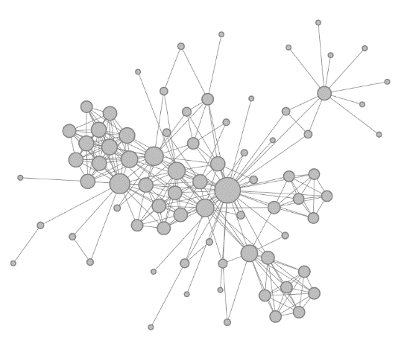


Introductory examples
Simple graph visualization
Several design steps led us to a visual representation that coveys important information about the data much better than the JSON format

Slide 42
Introductory examples
Enhancing the data analysis
Interactive visual data analysis usually targets challenging data analysis scenarios
  Large data: Data with many data elements
  Complex data: Data with many dimensions and attributes
Larger and more complex data require additional means of support
Examples:
  Dynamic filtering
  Multiple coordinated views

Slide 43
Introductory examples
digraph {
0 [
lon=0.000000000000000000e+00
lat=-8.750000000000000000e+01
betweenness=1.759682758549612799e+03
];
1 [
lon=3.750000000000000000e+00
lat=-8.750000000000000000e+01
betweenness=7.315325680869069629e+02
];
… ( 6,814 more nodes)
0 -> 1 [
geodesic_distance=0.000906
edge_betweenness=1.613004
];
0 -> 2 [
geodesic_distance=0.001816
edge_betweenness=1.829765
];
… (116,468 more edges)
}
Dynamic filtering
Climate network with 6,816 nodes and 116,470 edges
Plain visualization leads to cluttered and overcrowded representation

Slide 44
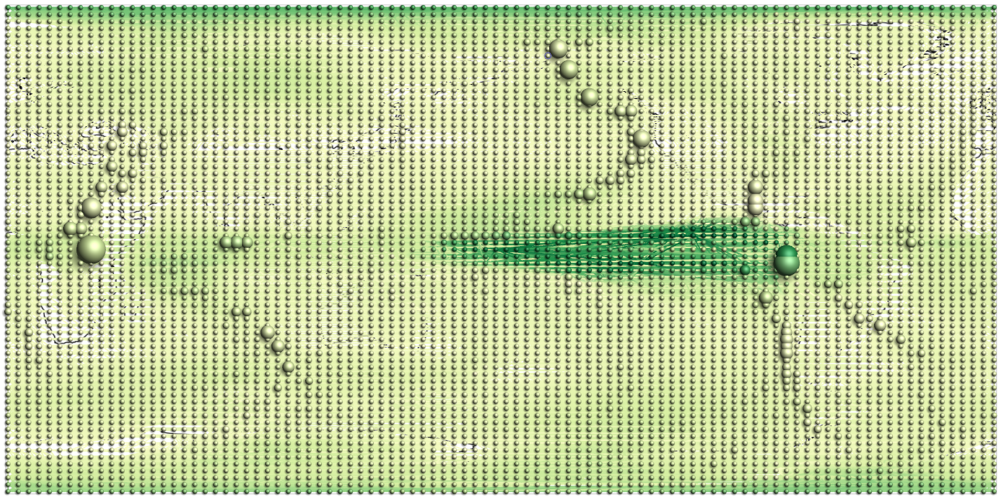
Introductory examples
Complete network with 6,816 nodes and 116,470 edges

Slide 45
Introductory examples
Dynamic filtering
Question: How to reduce clutter?
Answer: Focus on relevant subsets.
Approach:
  Calculate betweenness centrality for each node
  Filter out nodes with low centrality
  Interactively adjust filter threshold as needed
*Note how the visualization is supported by computation and interaction
Betweenness centrality is a graph-theoretic measure that quantifies how often a node acts as a bridge along the shortest path between two other nodes.

Slide 46
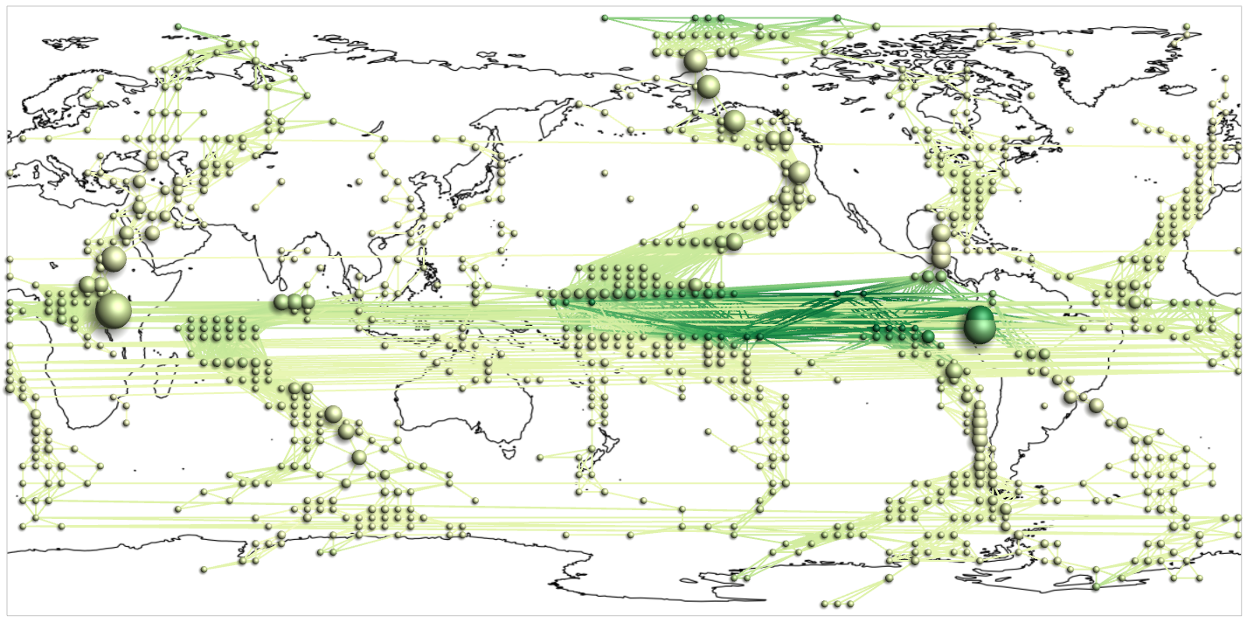
Introductory examples
Filtering based on betweenness centrality reduced the network to 938 nodes and 5,325 edges

Slide 47
Introductory examples
Coordinated multiple views
Question: How to represent many different data facets?
Answer: Create multiple views each emphasizing one or two selected aspects of the data.
Approach:
  Employ different techniques to create different views
  Arrange views and present them to the user
  Coordinated interaction highlights the same data in all views

Slide 48
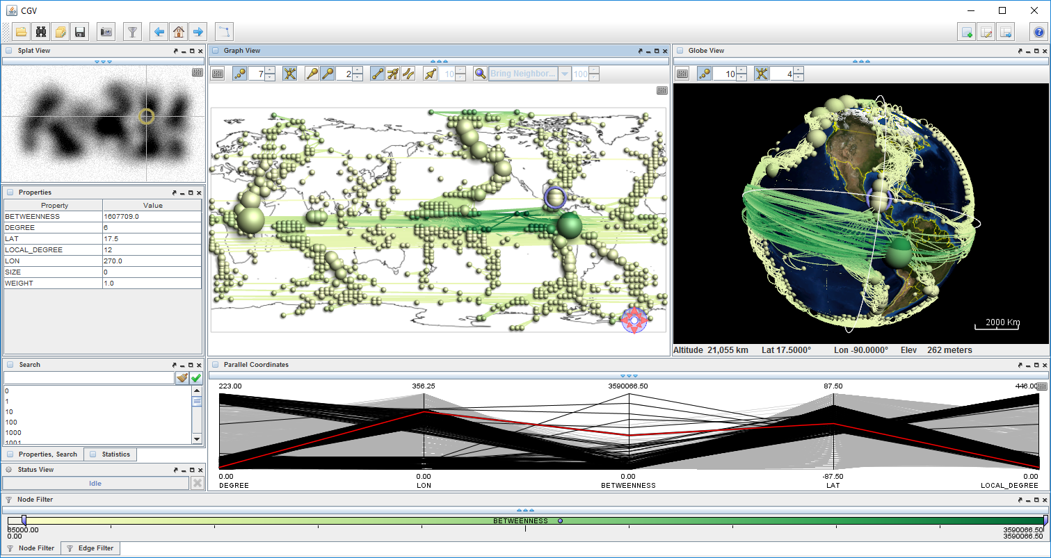
Introductory examples
Multiple views provide different perspectives on the same data

Slide 49
Introductory examples
Considering advanced methods
How far can we go with interactive visual data analysis?
  Computations must generate results in a timely fashion
  Visualization must fit on the screen
  Interaction must not overwhelm the user
Examples for pushing the limits
  On-demand user guidance
  Expanding interactive visual data analysis to larger scale

Slide 50
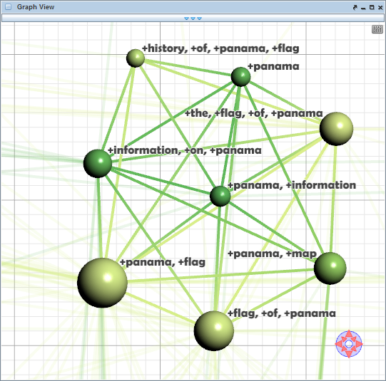
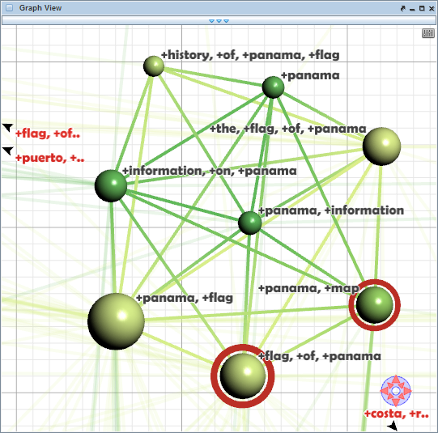
Introductory examples
On-demand user guidance during data navigation
Guidance can be provided by means of visual cues.
Approach:
Determine potentially relevant data by means of a degree-of-interest (DoI) approach
Incorporate visual cues and navigation aids
User may or may not choose to make use of guidance
User: “Where should I go next?”
System: “Here are potential candidates!”

Slide 51
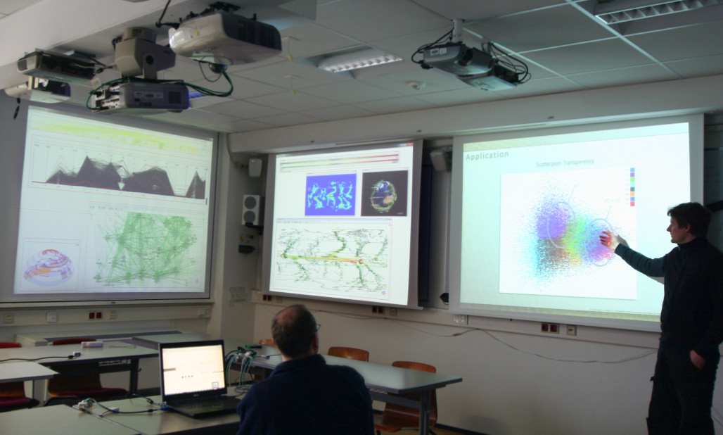
Introductory examples
Expanding interactive visual data analysis to larger scale
Distribute views to
multiple displays
Enable multiple analysts
to interact from multiple
devices
Facilitate collaborative
discussion and reasoning
Source: Radloff et al., 2011

Slide 52
Summary
What is interactive visual data analysis
Five Ws (what, why, who, where, when)
Introductory examples
  Simple graph visualization
  Dynamic filtering
  Coordinated multiple views
  On-demand user guidance
  Visual analysis in multi-display environments

Slide 53
Assignments
Look for an interesting visual representation of data in print or online media! Think about the 5 Ws in the context of your example!
Look more closely at the weather forecast as a ubiquitous visualization of complex data! Think about the 5 Ws!

Slide 54
Questions
What is interactive visual data analysis?
What are benefits and difficulties of computation, visualization, and interaction?
What is the key message behind Anscombe’s quartet?
Name and explain the five Ws of interactive visual data analysis!
Give an example of a simple visual representation of a graph (or network)!
How can the analysis of large data be facilitated via dynamic filtering?
What is the idea behind coordinated multiple views?
What are advantages and challenges of conducting interactive visual data analysis in a multi-display environment?

